Slide 1
Keys in a Relational Database

Slide 2
General Guideline
© (2021) ABES Engineering College.
This document contains valuable confidential and proprietary information of ABESEC. Such confidential and proprietary information includes, amongst others, proprietary intellectual property which can be legally protected and commercialized. Such information is furnished herein for training purposes only. Except with the express prior written permission of ABESEC, this document and the information contained herein may not be published, disclosed, or used for any other purpose.

Slide 3
Module Objective
To describe the structure of Relational Model .
To understand database schema , relational model objects and characteristics of relations
To discuss different keys in relational database like Super Key , Candidate key ,Primary Key , Composite Key , Secondary Key or Alternate Key , Surrogate Key , Foreign and Unique Key
To explain different constraints like schema based or integrity , entity integrity or key , Referential integrity and domain constraints
To discuss SMS Case study with all constraints
To understand basic concepts of SQL

Slide 4
Session Plan
Database keys
Objectives of Database Keys
Types of Database Keys

Slide 5
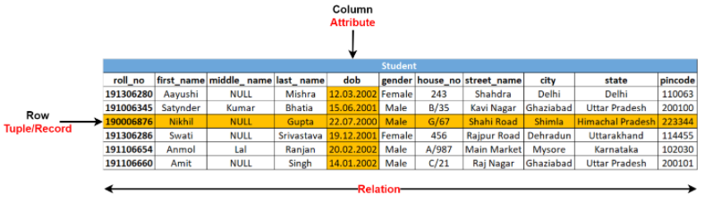
Need of Database key
In a database relation, it is easy to identify a particular (specific) column; however, we need a mechanism (way) to identify a particular (specific) row in a database relation. For this, the concept of database keys is used so that we can identify each row uniquely.

Slide 6
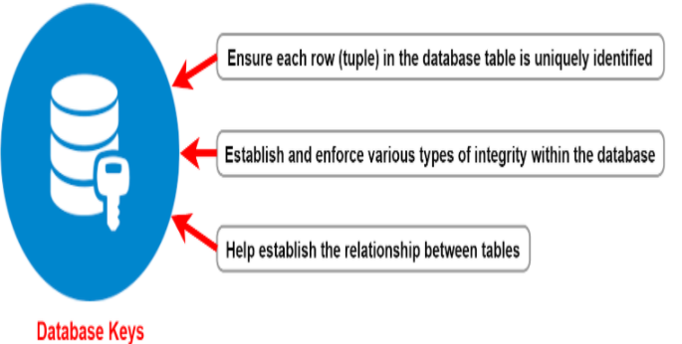
Database key
A database key (database relation key) is an attribute or a set of attributes in a particular relation that can uniquely identify each row (tuple) in that relation.
Database keys have three primary objectives given in below figure.

Slide 7
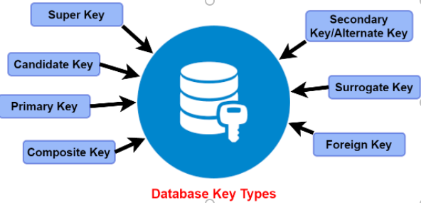
Type of database keys
There are mainly seven different types of Keys in DBMS and each key has its different functionality:

Slide 8
Super Key
A super key (SK) is a set of one or more attributes that allows us to uniquely identify a row (tuple) in the relation.
SK is a set of attributes of a relation schema R with the property that no two tuples t₁ and t₂ in any relation state r of R should have the same combination of values for these attributes. This is known as uniqueness property.
Thus, we can state that: t₁[SK] ≠ t₂[SK] or t₁.SK ≠ t₂.SK
Example:1.(roll_no, first_name, last_name)
2.(roll_no)
We can say that t₁[roll_no, first_name, last_name] ≠ t₂[roll_no, first_name, last_name] similarly, t₁[roll_no] ≠ t₂[roll_no].

Slide 9
Super Key(Contd..)
Consider the Schema, STUDENT(adhaar_no, roll_no, first_name, last_name, address, dob, gender, mobile_no, email_id).
Maximum no. of possible super keys for a relation with n attributes = 2^{n}-1
Below are some sets of super keys for the above STUDENT schema:
Thus student relation with 9 attributes maximum no. of possible super keys will be equal to 2⁹-1.
SK1 = (adhaar_no) SK2 = (roll_no) SK3 = (mobile_no) SK4 = (email_id) SK5=(adhaar_no, first_name, last_name) SK6 =(roll_no, first_name, last_name ) | SK7 = (first_name, last_name, address, mobile_no) SK8 = (roll_no, first_name, gender) SK9 = (first_name, last_name, address, email_id) SK10 = (first_name, mobile_no, email_id, dob) etc.

Slide 10
Some facts to remember about super keys
A super key specifies uniqueness property for a row (tuple) i.e. t₁ [SK] ≠ t₂ [SK] .
Every relation has one default super key, i.e., the set of all attributes of that relation.
A super key can have extraneous attribute/s. For super key SK2 i.e. {roll_no, first_name, last_name}, first_name and last_name are extraneous attributes. If we remove these attributes, then also uniqueness property holds.
If SK is a super key, then any superset of SK will also be a super key.

Slide 11
Candidate Key
A candidate key is a minimal super key that can identify each row (tuple) of a given relation uniquely.
A candidate key has a minimum number of attributes that are definitely needed to establish a row (tuple) uniqueness in a given relation.
The set of all possible candidate keys is known as the candidate key set.
Example: Consider STUDENT(adhaar_no, roll_no, first_name, last_name, address, dob, gender, mobile_no, email_id) below are the candidate keys:
CK1=(adhaar_no), CK2 = (roll_no) , CK3 = (first_name, last_name,address),
CK4 = (email_id)

Slide 12
Some facts to remember about candidate keys
All the attributes in a candidate key are sufficient as well as necessary to identify each tuple uniquely.​
Removing any attribute from the candidate key fails in identifying each tuple uniquely.​
The value of the candidate key must always be unique.​
The value of the candidate key can never be NULL.​
It is possible to have multiple candidate keys in a relation.​
Those attributes which appear in any candidate key are called prime attributes.​
A candidate key is a super key but not vice versa.

Slide 13
Primary Key
A primary key is a constraint in a table which uniquely identifies each row record in a database table by enabling one or more the column in the table as primary key.
A relation can have many candidate keys, which can uniquely identify each row (tuple) of a given relation. Any one of these candidate keys can be chosen as a Primary key (PK) of a given relation.
Some facts to remember about primary keys are given below:
The value of the primary key field will always be unique​
The value of a primary key field can never be NULL
A relation is allowed to have only one primary key

Slide 14
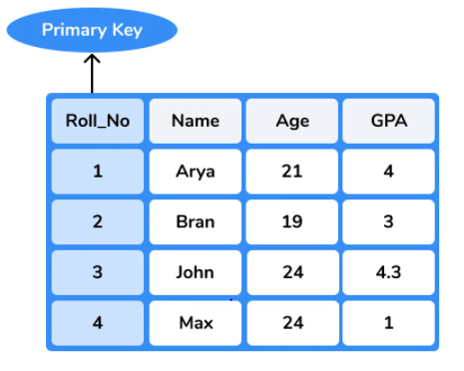
Primary Key(Contd..)
The primary key should be chosen such that:
Its attributes are never, or very rarely, changed , i.e., time-invariant.
It should consist of either a single attribute or a small number of attributes.

Slide 15
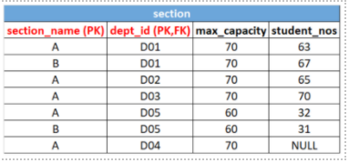
Composite key
A composite key is a primary key consisting of two or more columns that uniquely identify rows in a relation.
The combination of columns guarantees uniqueness, though individually uniqueness is not guaranteed. Hence, they are combined to identify records in a relation uniquely.
Example: Consider Section table
composite key consisting of
(section_name) and (dept_id).

Slide 16
Secondary Key or Alternate key
Secondary or Alternate key (s) are the candidate keys that are left unimplemented or unused after implementing the primary key.
The secondary keys are used for data retrieval purposes and indexing. Indexing is done for better and faster data searching and retrieval from the database.
If in the student relation, (roll_no) is designated as a primary key, the remaining candidate keys – (adhaar_no), (email_id), (first_name, last_name, address) are the secondary keys or alternate keys of the student relation.

Slide 17
Can you answer these questions
Which one of the following is a set of one or more attributes taken collectively to uniquely identify a record?
a) Candidate key b) Sub key c) Super key d) Foreign key

Slide 18
Can you answer these questions
Which one of the following is a set of one or more attributes taken collectively to uniquely identify a record?
a) Candidate key b) Sub key c) Super key d) Foreign key

Slide 19
Can you answer this ?
2. The subset of a super key is a candidate key under what condition?
a) No proper subset is a super key b) All subsets are super keys c) Subset is a super key d) Each subset is a super key

Slide 20
Can you answer this ?
Q. A _____ is a property of the entire relation, rather than of the individual tuples in which each tuple is unique.
a) Rows b) Key c) Attribute d) Fields

Slide 21
Can you answer this ?
Q. An attribute in a relation is a foreign key if the _______ key from one relation is used as an attribute in that relation.
a) Candidate b) Primary c) Super d) Sub

Slide 22
Can you answer this ?
Q. In RDBMS Relationships between tables created by using
Alternate Keys
Foreign Keys
Candidate Keys
Composite Keys

Slide 23
Can you answer this ?
Q. In RDBMS Relationships between tables created by using
Alternate Keys
Foreign Keys
Candidate Keys
Composite Keys

Slide 24
Can you answer this ?
Q. Which one is correct with respect to RDBMS
Primary Key ⊆ Super Key ⊆ Candidate Key
Primary Key ⊆ Candidate Key ⊆ Super Key
Super key⊆ Candidate Key ⊆ Primary key
Super key ⊆ Primary key ⊆ Candidate key

Slide 25
Can you answer this ?
Q. Which one is correct with respect to RDBMS
Primary Key ⊆ Super Key ⊆ Candidate Key
Primary Key ⊆ Candidate Key ⊆ Super Key
Super key⊆ Candidate Key ⊆ Primary key
Super key ⊆ Primary key ⊆ Candidate key

Slide 26
Can you answer this ?
Q. A prime attribute of a relation scheme R is an attribute that appears
(GATE 2014)
in all candidate keys of R.
in some candidate key of R.
in a foreign key of R.
only in the primary key of R.

Slide 27
Can you answer this ?
Q. A prime attribute of a relation scheme R is an attribute that appears
(GATE 2014)
in all candidate keys of R.
in some candidate key of R.
in a foreign key of R.
only in the primary key of R.

Slide 28
Can you answer this ?
Q. Which of the following statements are not true?(GATE 2017)
Superset of a superkey is also a superkey.
Superset of a candidate key is a superkey.
Subset of a candidate key can be a superkey.
Proper subset of a candidate key is also a candidate key.

Slide 29
Can you answer this ?
Q. Which of the following statements are not true?(GATE 2017)
Superset of a superkey is also a superkey.
Superset of a candidate key is a superkey.
Subset of a candidate key can be a superkey.
Proper subset of a candidate key is also a candidate key.

Slide 30
Surrogate Keys
A surrogate key is a system-generated value with no business meaning that is used to identify a record in a relation uniquely. This key is used as a primary key in a given relation when a natural primary key is not available.
The surrogate key is usually an integer and thus does not lend any meaning to the data in the relation. A surrogate key is a value generated right before the record is inserted into a relation.
When the primary key is too big or complicated, Surrogate keys are preferred. A surrogate key is generated for each unique combination of the primary key.

Slide 31
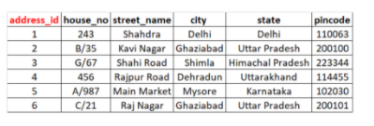
Surrogate Keys(Contd..)
Example:
key comprising of a combination of various components of address (house_no, street_name, city, state, Pincode).
A surrogate key can be introduced as address_id for each unique combination of address (house_no, street_name, city, state, Pincode).

Slide 32
Foreign Key
When the primary key (PK) of one relation (also referred to as parent relation) is included as a non-unique attribute in another relation (also referred to as child relation), then such a database key is called a foreign key (FK).
The primary purpose of the foreign key (FK) is to define and create a relationship between the two relations.
The relation which is being referenced is called referenced relation, and the corresponding attribute is called a referenced attribute.
The relation which refers to the referenced relation is called referencing relation, and the corresponding attribute is called referencing attribute.

Slide 33
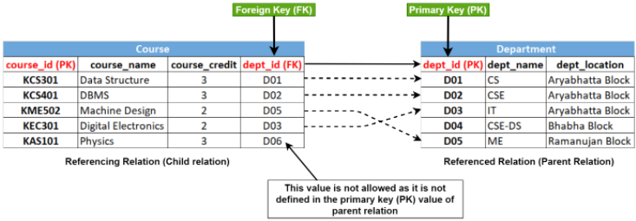
Foreign Key (Contd..)
Example:
In below given figure attribute (dept_id) in course relation is a foreign key (FK), and all values for this attribute will match the values of the primary key (PK) attribute (dept_id) in the department relation.

Slide 34
Unique Key
Unique key constraints also identifies an individual tuple uniquely in a relation or table.
Multiple unique keys can present in a table. NULL values are allowed in case of a unique key. These can also be used as foreign keys for another table
It can be used when someone wants to enforce unique constraints on a column and a group of columns which is not a primary key.
Example: In Department relation, dept_name is a unique key and in Course relation, course_name is a unique key.

Slide 35
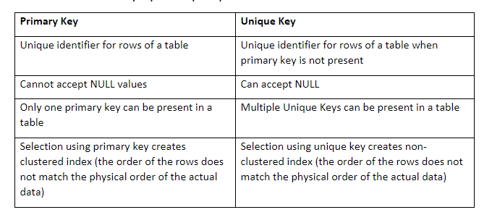
Difference between Primary Key and Unique Key

Slide 36
Review Questions
Q 1.What are Super key, Primary key, Candidate key, and Foreign keys?
Q 2. What is the difference between Primary key and Unique key?
Q 3. What is importance of keys in Database?

Slide 37
Thank You

